Slide 1
The Battle of Neighborhoods
Selecting a suitable location to rent residential property in Bangalore, India

Slide 2
Introduction & Business Problem
Bangalore is widely regarded as the "Silicon Valley of India" (or "IT capital of India") and the IT firms employ about 1.5 million employees in the IT and IT-enabled services sector.
The vast amount of job opportunities attracts workforce from all around the country as well as other parts of the state.
The business problem we will solve is: From the overabundant residential properties, how would the migrant workforce decide the most suitable location to rent residential properties.

Slide 3
Data Collection
The rental rates data are extracted from the “Makaan.com” website.
Python GeoPy package (Nominatim API) is used to get the Longitude and Latitude data of the localities in Bangalore.
FourSquare API interface is used to explore the localities and their neighborhoods.

Slide 4
Methodology
Bangalore rental rates data from Makaan.com website is scraped using BeautifulSoup and converted into a pandas dataframe.
Longitude and Latitude data of the localities are obtained using Python GeoPy package (Nominatim API).
K-means clustering is used to cluster the localities based on the rental rates for 1BHK, 2BHK and 3BHK.
FoursquareAPI is used to explore the venues of each locality.
K-means clustering is used to cluster the localities base on venues.

Slide 5
Results

Slide 6
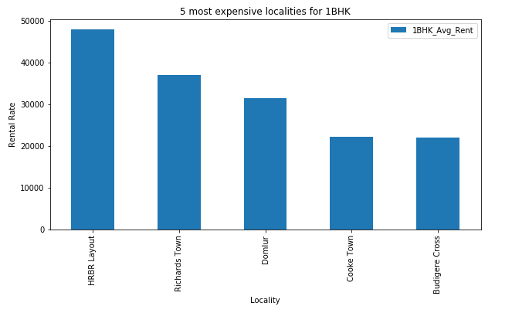
5 Most Expensive Localities for 1BHK

Slide 7
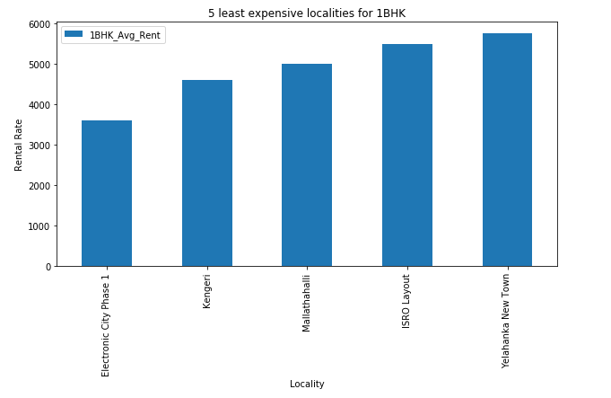
5 Least Expensive Localities for 1BHK

Slide 8
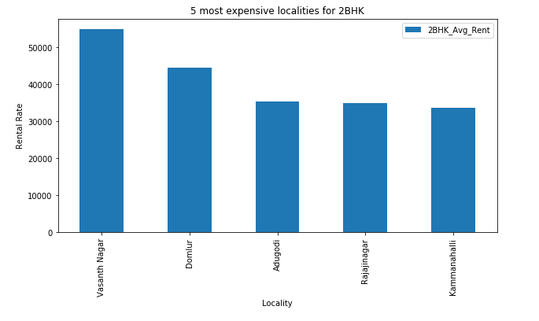
5 Most Expensive Localities for 2BHK

Slide 9
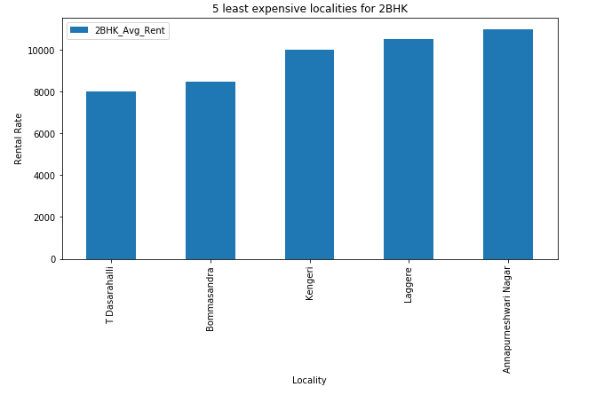
5 Least Expensive Localities for 2BHK

Slide 10
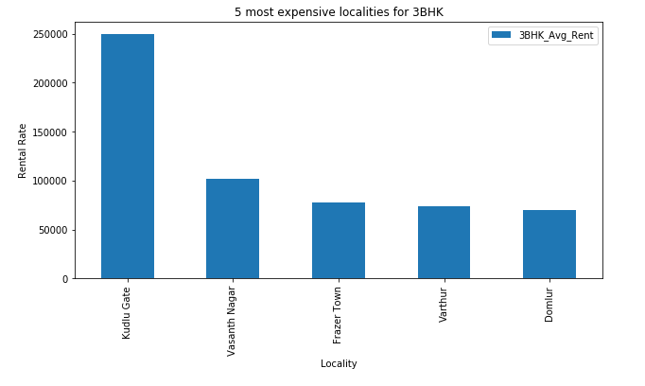
5 Most Expensive Localities for 3BHK

Slide 11
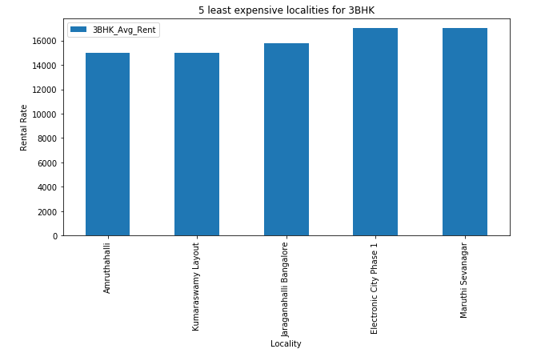
5 Least Expensive Localities for 3BHK

Slide 12
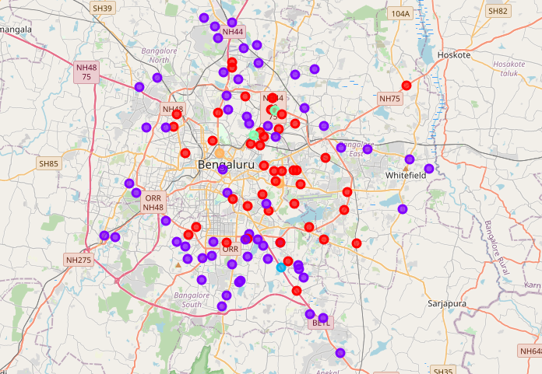
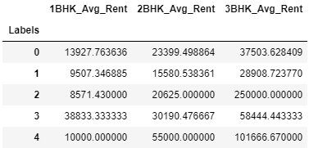
Clustering of Localities based on Rental Rates
Localities in Cluster 2 have an overall lower rental rates for 1BHK, 2BHK and 3BHK residential properties.

Slide 13
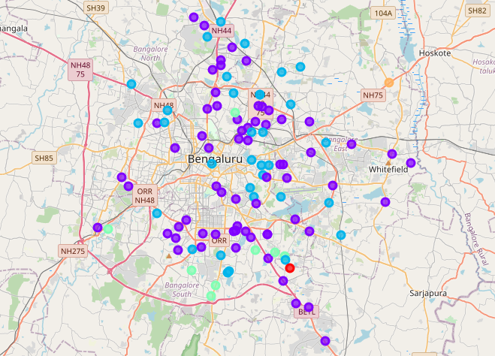
Clustering of Localities based on Venues

Slide 14
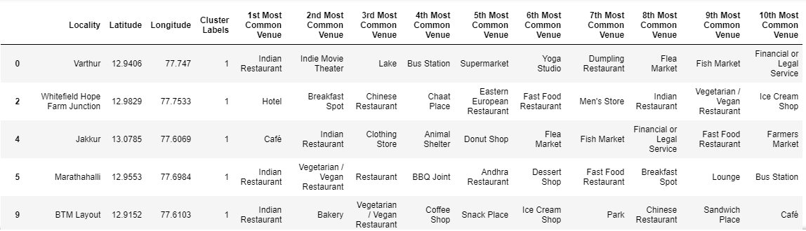
Cluster 1
Cluster 2
Cluster 5

Slide 15
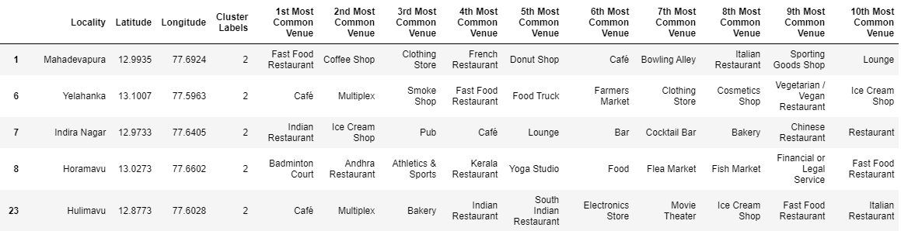
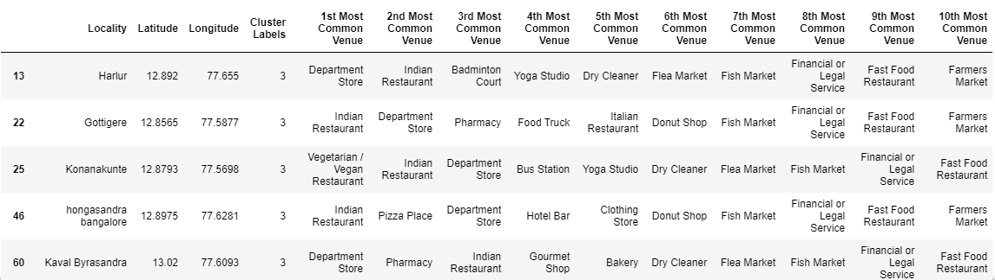
Cluster 3
Cluster 4

Slide 16
Observations
Based on the rental rates, localities of Cluster 2 and to a lesser extent Cluster 1 are the best places to rent residential properties. Cluster 2 has the overall lowest average rental rates.
Based on venues, people who prefer dining outside most of the times should consider localities from Cluster 2 as they would have a wide variety of eateries at their disposal.
Based on venues, people who prefer places for evening entertainment and nightlife should consider localities from Cluster 3.
Based on venues, for a family, Cluster 4 would be suitable. These localities most commonly have Department stores, markets, pharmacy mixed with some restaurants and bus stops

Slide 17
Conclusion
This project makes use of rental rates and nearby venues to give a better understanding of the localities in Bangalore while choosing a place to rent.
For further studies, crime rate data and distance from workplace data can be taken into consideration.

